Slide 1
Digital Portfolio
STUDENT NAME: ARUNESHAN G V
REGISTER NO AND NMID: CADD7A32BEFBF9EB4E642CED919D0504
DEPARTMENT: BCA
COLLEGE: Akshaya College of arts and Science / Bharathiyar University

Slide 2
PROJECT TITLE
UrbanFolio: A Sleek Modern Portfolio

Slide 3


AGENDA
Problem Statement
Project Overview
End Users
Tools and Technologies
Portfolio design and Layout
Features and Functionality
Results and Screenshots
Conclusion
Github Link
3/21/2024 Annual Review

Slide 4

PROBLEM STATEMENT
In today’s professional world, first impressions matter. Most online portfolios are either too flashy to feel professional or too plain to leave an impact. This creates a challenge for students and professionals who want to stand out while still looking polished. UrbanFolio solves this by bringing a clean, urban-inspired design with dark tones, subtle highlights, and a balance of style and professionalism.

Slide 5

PROJECT OVERVIEW
UrbanFolio is a sleek and modern digital portfolio website designed with a city-inspired aesthetic. Using a monochrome base with accent colors (like orange or teal), it creates a professional yet stylish environment to showcase skills, achievements, and projects. The website is built with HTML, CSS, and JavaScript, focusing on simplicity, smooth layouts, and mobile responsiveness, so it looks great on any device.

Slide 6

WHO ARE THE END USERS?
🎓 Students – who want to present academic work in a clean, professional format.
💼 Job Seekers – especially in IT, finance, and corporate industries.
👨‍💻 Developers & Professionals – to highlight coding projects, skills, or services.
🏢 Employers & Recruiters – who need an easy, engaging way to review candidates.

Slide 7

TOOLS AND TECHNIQUES
Frontend: HTML5, CSS3, JavaScript
Editor: Visual Studio Code
Hosting: GitHub Pages / Netlify
Design Style: Minimal dark/light contrast, accented with orange or teal, plus smooth transitions.

Slide 8
POTFOLIO DESIGN AND LAYOUT
A dark header with bold, modern typography.
A horizontal navigation bar with clean hover highlights.
An About section featuring a profile and skill grid.
A Projects section with sleek cards and hover-zoom effects.
A Contact section with minimalist icons and links.
A professional footer that keeps the design grounded.
‹#›

Slide 9
FEATURES AND FUNCTIONALITY
🚀 Smooth navigation powered by JavaScript.
🏙️ Urban theme with balanced dark/light contrasts.
📂 Projects section styled with modern card layouts.
🖱️ Hover animations for subtle interactivity.
📱 Responsive design for desktop, tablet, and mobile.
🔗 Clickable links with accent color highlights.

Slide 10

RESULTS AND SCREENSHOTS
Delivered a sleek and professional portfolio with an urban theme.
Organized projects and skills into a clear, formal layout.
Added smooth hover animations and transitions.
Verified responsive design across devices.
Found a perfect balance between creativity and professionalism.
3/21/2024 Annual Review
‹#›

Slide 11
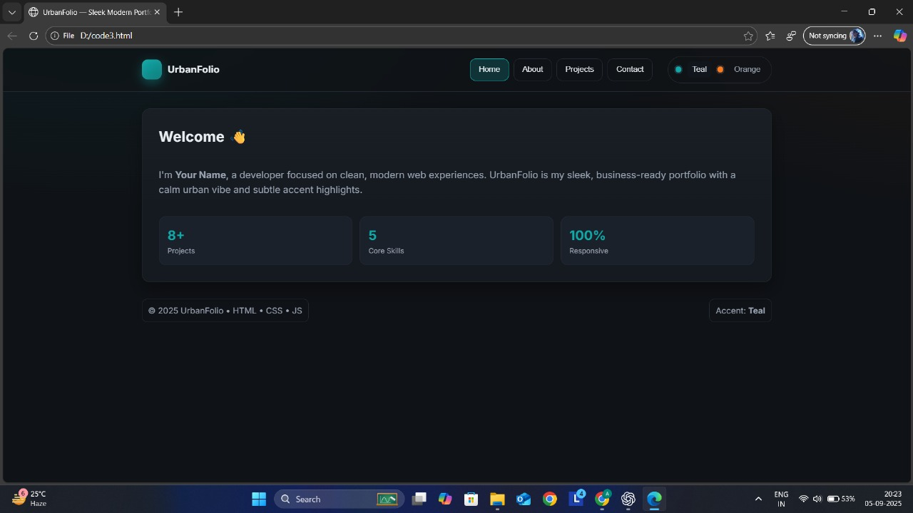

Slide 12
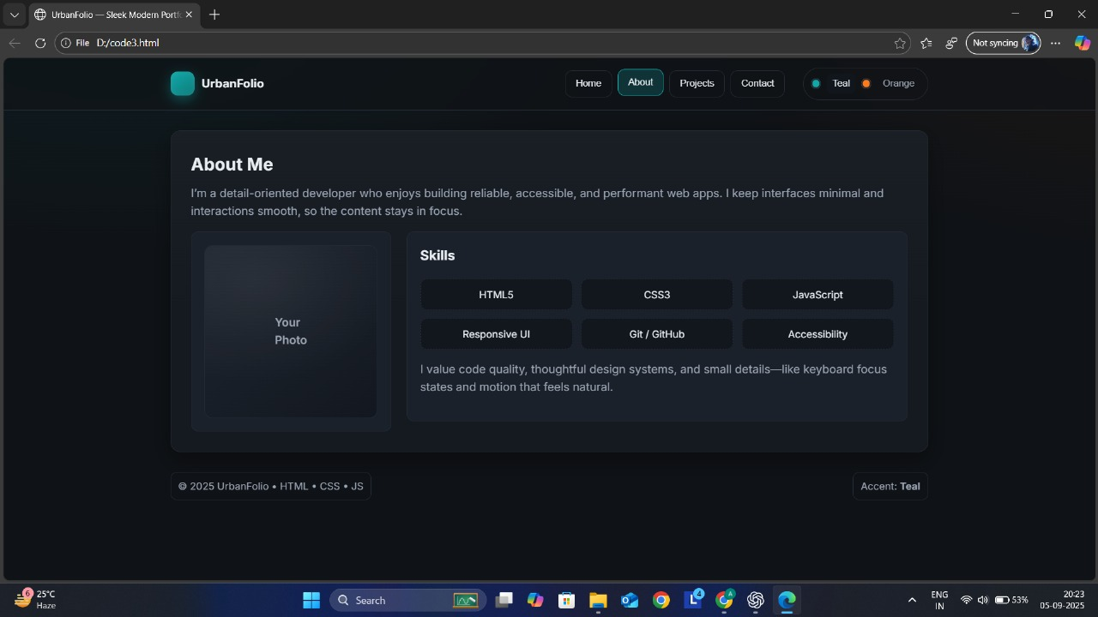

Slide 13
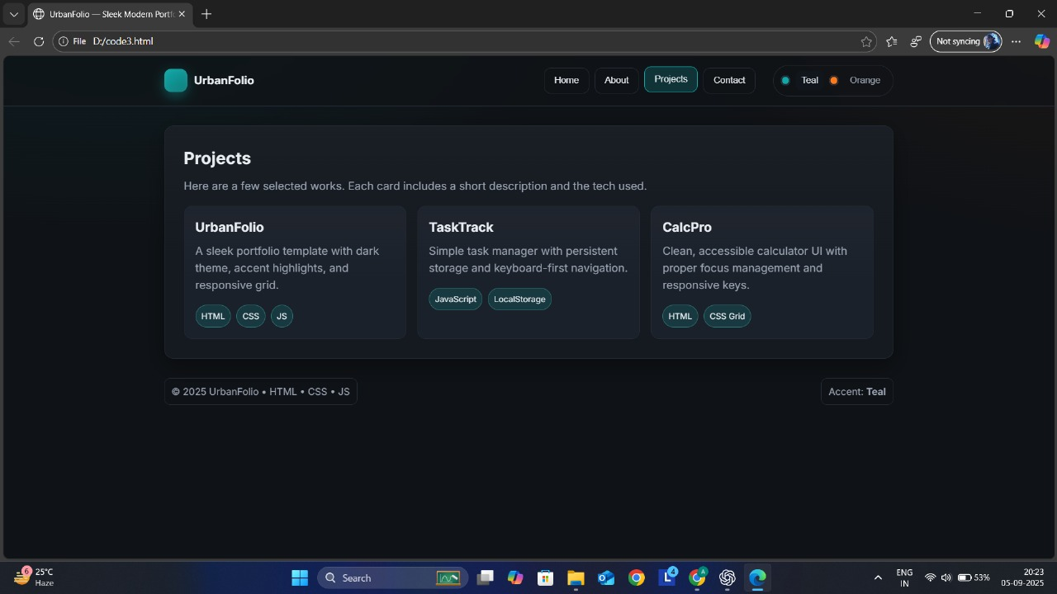

Slide 14
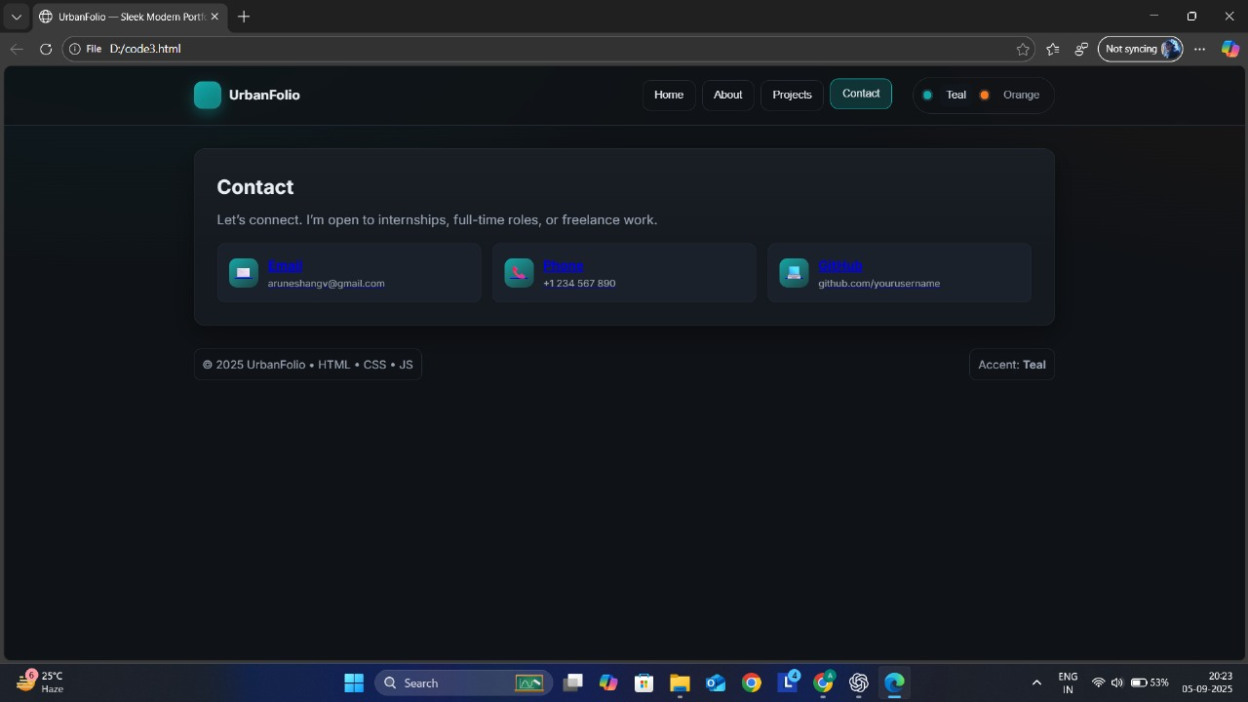

Slide 15
CONCLUSION
The UrbanFolio project proves that portfolios don’t need to be overly flashy or boring to be effective. With its clean urban design, subtle animations, and professional tone, it’s a perfect fit for students, job seekers, and professionals aiming to make a strong impression. UrbanFolio strikes the balance between creativity and clarity — making it a modern alternative to traditional resumes.
‹#›

